Slide 1
Navigating the Institutional Review Board (IRB) Process
Jessica L. Yoos, M.A., M.Phil.Ed, CIP
Director, Human Research Protections
Office of the IRB
Human Research Protections Program

Slide 2
Agenda
What is an IRB?
  What does the IRB do?
  Why are IRBs necessary?
Types of Research
Design and Review Considerations
Submission Process and Helpful Tips

Slide 3
1.
What is an Institutional Review Board (IRB)?
Why are IRBs Necessary?
Notes:
The IRB is an ethics committee comprised

Slide 4
What is an Institutional Review Board (IRB)?
The Institutional Review Board (IRB) is an ethics committee
  Formally designated in federal regulations to review, approve and monitor biomedical and behavioral research to ensure the safety, rights, and welfare of human participants are adequately protected
An IRB is comprised of a diverse group of scientists, non-scientists, and community members.
Penn has 7 biomedical committees and 1 social-behavioral committee
The committees are supported by the IRB Office, which is comprised of 23 staff members

Slide 5
What Does the IRB Do?
Review research from the Penn research community
IRBs are also tasked with determining both the degree and likelihood of risk in the research
  Minimal risk: “the probability and magnitude of harm or discomfort anticipated in the research are not greater in and of themselves than those ordinarily encountered in daily life or during the performance of routine physical or psychological examinations or tests.”
Minimal
Greater than minimal

Slide 6
Why were IRBs Created? Some Examples:
Tuskegee Syphilis Experiment (1932-72):
In a study funded by the U.S. Public Health Service, researchers examined the effects of syphilis in African American males. Subjects were deceived about their true illness, given useless treatment, and denied access to known treatments such as penicillin
Henrietta Lacks (1950s)
Henrietta Lacks was an African American woman who sought treatment at Johns Hopkins Hospital for cervical cancer. Her cells were taken without her consent and are the basis for the HeLa cell line
Holmesburg Prison Experiments (1951-74)
Experiments were performed on inmates, including implantation of foreign bodies, burns and radiation of the skin, exposure to dioxin, application and ingestion of toxic, near lethal doses of retinoin A, and the yanking out of fingernails.

Slide 7
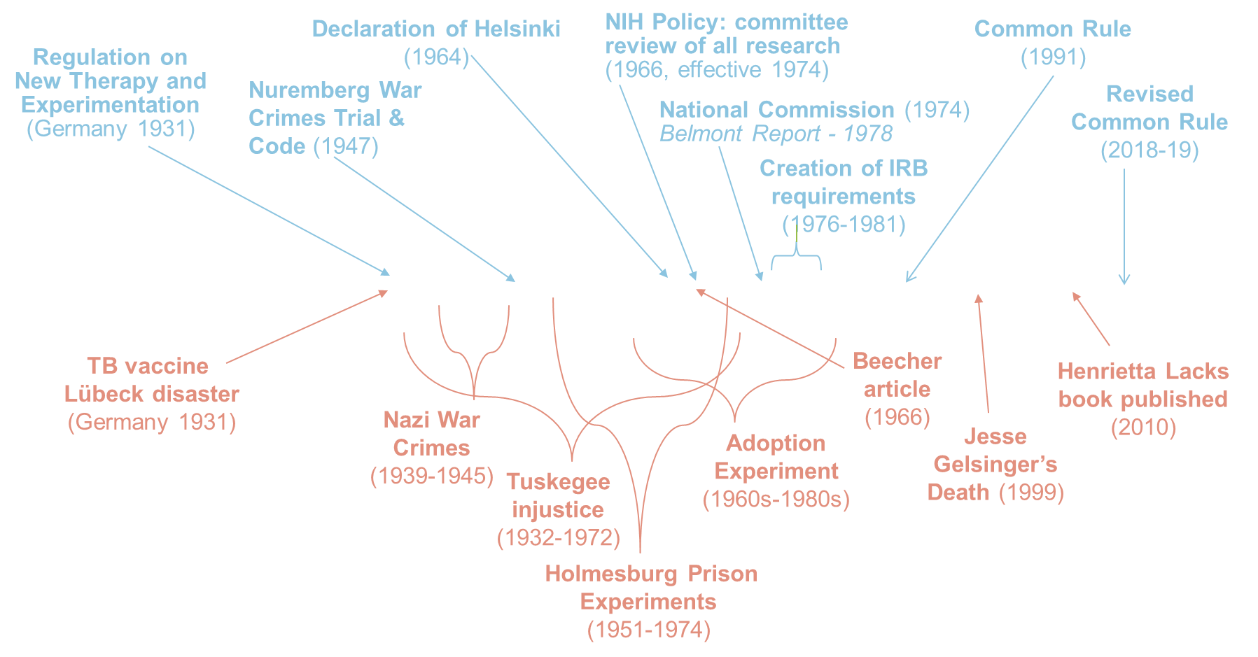
Why are IRBs Needed Today?
Notes:
TB Vaccine: https://www.ncbi.nlm.nih.gov/pmc/articles/PMC4721647
In an accident later known as the Lübeck disaster, 251 neonates were orally given three doses of the new Bacille Calmette–Guérin (BCG) antituberculosis (TB) vaccine contaminated with Mycobacterium tuberculosis. A total of 173 infants developed clinical or radiological signs of TB but survived the infection, while 72 died from TB.
Adoption Experiment: https://pubmed.ncbi.nlm.nih.gov/32366700
An experiment, conducted in the 1960's through 1980's, that involved identical siblings who were adopted as infants and separated into different families to examine the effects of nature versus nurture. The organisation coordinating the study donated the research records to Yale University under the condition that they remain sealed until 2065, and has impeded study participants' full access to research material.
Beecher article:
In the summer of 1966, Henry K Beecher published “Ethics and Clinical Research”, a landmark article, often called “Beecher's bombshell”, which described 22 examples of clinical research he deemed ethically questionable. Beecher reviewed 50 studies, but only 22 reported in the article for space. Only 2 out of 50 mentioned consent.
Jesse Gelsinger (1999): https://med.nyu.edu/departments-institutes/population-health/divisions-sections-centers/medical-ethics/education/high-school-bioethics-project/learning-scenarios/jesse-gelsinger-case
17-year-old Jesse Gelsinger volunteered for a gene therapy experiment at Penn. He was informed that previous subjects had received the product without serious complications. He had a negative reaction and passed away 4 days later.

Slide 8
Impact of Past Abuses on Research Today
Trust
Implicit Bias
Generalizability
Past abuses have created issues with the public’s trust of researchers, especially among African Americans in the US.
Implicit biases within healthcare likely bleed over into research and impact communication, thus, decreasing the likelihood of participation
The goal of research is to contribute to generalizable knowledge. Lack of diversity in research impacts study results. How can the results be generalized to groups who refuse participation?

Slide 9
So, What Can we Do?
Educate Ourselves
Improve Diversity
Among IRB membership
ACTIVE Community Involvement
Examining differences across racial/ethnic groups should be done in a responsible way, explored carefully, and without assumptions of biological variation.
Among research participants without putting all the burden on one group (equitability)
Engage to determine the community’s priorities
Give back and disseminate results to the community.
Be aware of our implicit biases and eradicate them
Improve communication skills

Slide 10
2.
Types of Research
Notes:
The IRB is an ethics committee comprised

Slide 11
Levels of IRB Review
NHSR
Exempt / Limited Review
Expedited Review
Convened Board Review
Notes:
NHSR does not require review
Exempt refers to outlined exempt categories per DHHS regulations. Submission is required via HSERA
Expedited refers to outlined expedited categories per DHHS regulations. Expedited means this is a delegated review.
Convened boards review anything that does not fall under exempt and expedited categories and anything that is GTMR

Slide 12
Types of Studies: NHSR, Exempt, and Expedited
Examples of Exempt Studies
Examples of Expedited Studies
Research with drug / device products that is exempt from FDA IND & IDE regulations
Not Human Subjects Research (NHSR)
Not Research Example:
Using existing publicly available data (e.g., anyone can download from internet)
Benign behavioral interventions with adults
Secondary research with non-sensitive data or specimens
Surveys/ interviews/ focus groups with adults collecting non-sensitive data
Receiving identifiable data from data registries or research studies
Chart reviews
Receiving de-identified data or specimens where no link exists with identifiers
Research involving cadavers
Venous or fingerstick blood collection considering frequency, amount, and subject
Non-invasive collection of saliva, hair, nails, teeth, skin swab, sputum, etc.
Collection of data via non-invasive means (e.g., MRI without contrast, EEG, ECG, pulse ox, etc.)
Risks must be minimal
Not involving HS Examples:
Quality Improvement
Educational Project
Receiving identifiable biospecimens from a repository or biobank where broad consent was obtained
Research w/leftover identifiable clinical specimens
Case study of 3 or fewer patients
Notes:
NHSR: As defined by DHHS: “Research is a systematic investigation, including research development, testing and evaluation, designed to develop or contribute to generalizable knowledge.” Therefore, to meet this qualification the project would need to be determined to not be research OR not involve human subjects.
FDA regulations defines a human subject to be an individual (healthy volunteer or patient) who is a recipient of an FDA regulated product (e.g., drug, biologic, device, dietary supplement, etc.) or a control.

Slide 13
3.
Design and Review Considerations
Notes:
The IRB is an ethics committee comprised

Slide 14
How Does the IRB Determine Approval?
Approval Criteria
Risks to subjects are minimized
Equitable subject selection
Adequate protections to protect privacy and confidentiality
Additional safeguards for vulnerable subjects
Risks are reasonable in relation to benefits
Consent will be sought / documented
Notes:
Considering these elements will facilitate IRB review process.

Slide 15
Consent and HIPAA Authorization
Informed Consent/ HIPAA
Administering a drug or device for research purposes
Administering a clinical or behavioral intervention
Alteration of IC/ HIPAA
Must be minimal risk as determined by the IRB
Participants given option to opt out because intervention is being implemented across a whole hospital or health system
Waiver of Documentation of IC
Retrospective chart review
Collection of archived tissue clinical specimens
Waiver of IC and HIPAA
Interviews, Focus Groups, Surveys, Questionnaires
Prospective chart review plus phone survey
Non-invasive collection of specimens such as saliva, teeth, etc.
Notes:
There are certain criteria for waivers or alterations. However, our forms walk you through all that.

Slide 16
Informed Consent Process Best Practices
Time to consider and to ask questions
Coercion or undue influence is minimized
Information is understandable to the subject.
The participant receives a copy of the consent form
Notes:
The prospective subject must have sufficient opportunity to consider whether or not to participate
The possibility of coercion or undue influence must be minimized
The information that is given must be in language that is understandable to the subject
Must be grammatically understandable (generally we recommend that consent forms be written at a 7th grade reading level). However, with really complicated studies, this may be really difficult and this should be addressed during the consent process. The allowance of questions from subjects becomes vital in these cases.
If a participant doesn’t speak English, either translate the consent or use a short form ICF with a translator, and follow the IRB policy on this.
Consent must be documented (unless a waiver is granted by the IRB)

Slide 17
4.
Submission Process
& Helpful Tips
Notes:
The IRB is an ethics committee comprised

Slide 18
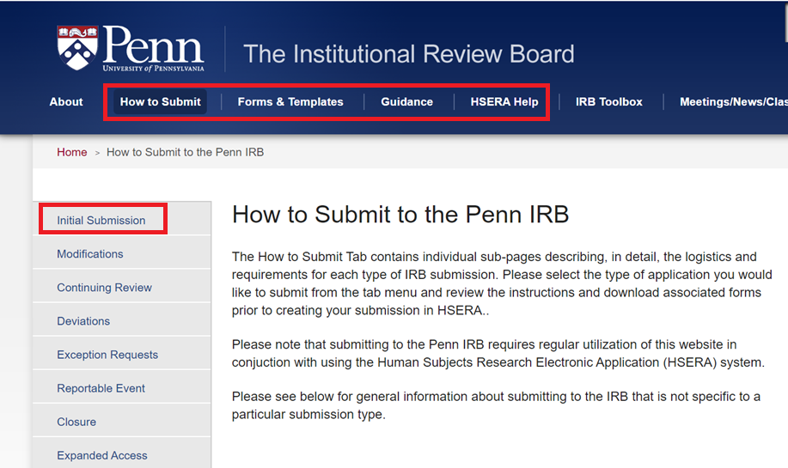
IRB Guidance: irb.upenn.edu
Notes:
Very brief slide (explaining the difference between the website and HSERA)

Slide 19
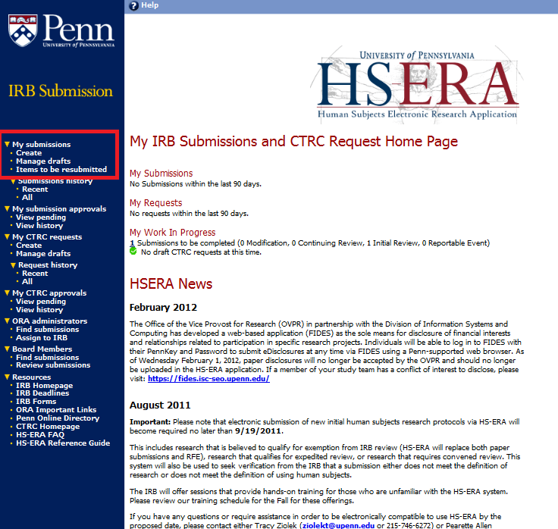
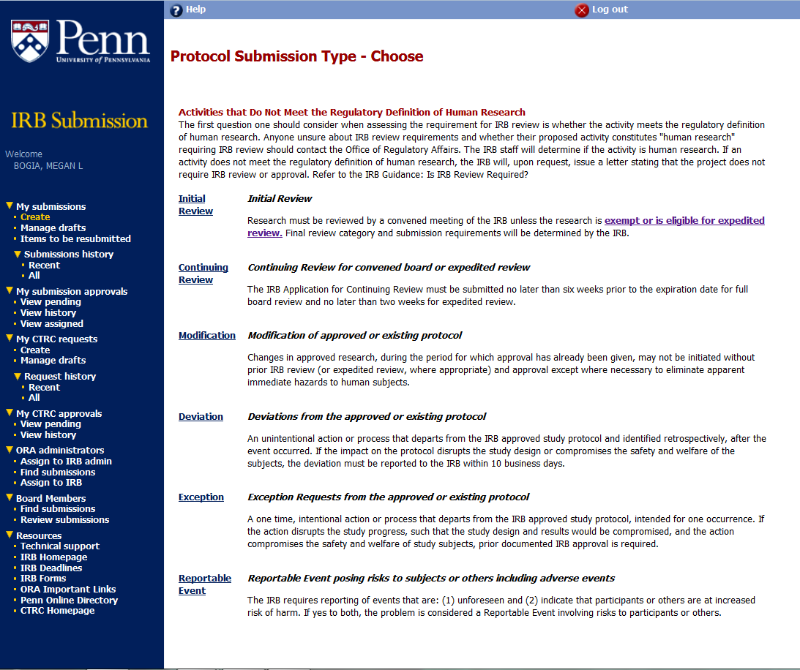
IRB Application: hsera.apps.upenn.edu
Notes:
Very brief slide
Penn-specific online platform for exempt, expedited, and FB submissions

Slide 20
How Studies are Reviewed
Study is Approved by PI & Chair of Dept.
Submitted Exempt/ Expedited & Minimal Risk
Reviewed by Analyst Team
Submitted as Convened and GTMR
Study is Received by the IRB Electronically
Screened by Administrator & then Full Board Review
Submitted Exempt /Expedited but risk unclear
Screened by Analyst & then Full Board Review
NOTE: For minimal risk studies, the “board” assignment won’t impact you

Slide 21
Ongoing IRB Review
Not Human Subjects Research
No review required
Exempt or Limited IRB Review
Initial Review Required
Minimal Risk w/ Expedited or Full Review
Initial Review Required
Greater than Minimal Risk w/ Full Review
Initial Review Required
Modifications Required
Modifications Required
Continuing Review Required
Continuing Review required if informed by IRB
Modifications with Limited Review
Notes:
The only biomedical research that is eligible for exemption from ongoing IRB review are chart reviews/secondary use of biomedical specimens. Everything else requires expedited or convened review. Anything determined to be FDA regulated requires continuing review regardless of risk (at this time). Per FDA. This would be any clinical investigation. Any study investigating a drug or device OR any study administering a drug product.

Slide 22
Helpful Tips
DO review Submission Guidance on our website
DO tell us what you want to do
DO make sure everyone has taken their CITI training
DO utilize Penn template protocols & consent forms
DO use simple language in consents and application
DO provide rationale
DO give yourself enough time & don't rush
DON’T repeat.
DON’T leave blank space in HSERA.

Slide 23
Best Practices
Complex and/or Greater than Minimal Risk Research
  Utilize a protocol template from our website
  Clearly delineate research aspects from usual care: required by the protocol = research
  Consider whether independent safety monitoring is appropriate based on the risk

Slide 24
Helpful Links
HSERA: https://hsera.apps.upenn.edu
IRB Website How to Submit Guidance: https://irb.upenn.edu/how-submit-penn-irb
  All types of submissions including Expanded Access
IRB Forms and Templates: https://irb.upenn.edu/forms
IRB Website—General Guidance: https://irb.upenn.edu/mission-institutional-review-board-irb/guidance
PSOM Office of Clinical Research: www.med.upenn.edu/ocr
  Get help with industry contracts, clinical research billing, submitting to FDA, clinical research operations, clinical research compliance

Slide 25
Who to Contact
IRB PO BOX
  For general IRB inquiries, including status of review progress, questions, concerns or complaints regarding IRB review @ irb@pobox.upenn.edu
HSERA Help Desk
  For technical issues with the online submission system @ hsera_help@lists.upenn.edu
CITI Training Help Desk
  For issues obtaining or documenting CITI training @ IRBCITISupport@lists.upenn.edu
Directory: https://irb.upenn.edu/directory
  Study is minimal risk and undergoing expedited or exempt review: Contact a Senior Analyst
  Study is undergoing convened review: Contact the Administrator of the board to which it’s assigned.

